Slide 1

Intrusion Detection and Prevention System (IDPS)
School of Computer Science and Engineering
Department of Computer Science and Engineering
Submitted By:
ANMOL SIKKA
23FE10CSE00181
KARTIKAYY PANGHAAL
23FE10CSE00196
Supervised By:
Dr Gireesh Kumar

Slide 2
Outline
Introduction
Literature Review
Problem Statement
Proposed Solution
Objectives
Results

Slide 3
Introduction
The rapid expansion of the internet has fundamentally changed how we handle security. We are no longer just protecting individual computers; we are defending an entire ecosystem of cloud services, IoT devices, and web-based platforms. As this digital landscape grows, so does the attack surface. Today’s attackers rarely use a single method; instead, they employ "blended" strategies. For example, a breach might begin with a simple phishing URL that looks harmless but serves as the gateway for a sophisticated network-level intrusion
The problem we face today is that our defenses are fragmented. Traditional Network Intrusion Detection Systems (NIDS) are excellent at spotting traffic anomalies, but they are often too heavy for real-time use and suffer from high false-alarm rates. On the other hand, standard URL filters rely almost entirely on static blacklists. This means they are effectively blind to "Zero-Day" threats or clever evasion tactics like domain mimicry and URL shortening. There is a significant gap between high-performance academic models and systems that are actually practical and easy for a human user to understand

Slide 4
Our Approach: A Unified, Hybrid Defense
To bridge this gap, my research proposes a hybrid framework that brings these two worlds together: a machine learning-based NIDS and a lightweight URL safety scanner. This dual-layered approach is designed for the real world. The NIDS module uses ensemble classification to recognize complex attack patterns within network data. Meanwhile, the URL scanner focuses on lexical and domain-level indicators, providing an instant safety verdict without the risk of actually executing harmful web content.
The ultimate goal of this project is to move away from purely theoretical experiments and toward a deployment-ready application. By prioritizing usability and low-latency performance, this framework provides a scalable solution that can eventually be integrated directly into a browser extension. This ensures that protection isn't just something happening in the background—it’s providing immediate, interpretable alerts to keep users safe while they browse

Slide 5
Literature Review
Historically, protecting a network relied on matching traffic against a database of known threats. However, as attacks became more diverse—especially with the rise of IoT and cloud computing—research shifted toward machine learning to spot "anomaly-based" intrusions that don't have a signature yet. Influential surveys, such as those by Buczak and Guven, have shown that supervised models like Random Forest and SVM can achieve high accuracy compared to purely rule-based systems
Despite these technical gains, a major theme in recent literature is the "deployment gap". Most academic research relies heavily on offline benchmark datasets like NSL-KDD, but these models often struggle to generalize when faced with the messy, high-speed reality of live network traffic. Furthermore, while Deep Learning models (like CNNs or LSTMs) can learn complex patterns, they are often criticized for being "black boxes" that require immense computational power, making them impractical for lightweight or edge environments
.

Slide 6
While NIDS focuses on what is happening within the network, we cannot ignore how these threats start. A significant portion of modern breaches begin at the application layer, specifically through malicious links. Research by Joshi et al. and Sahoo et al. has demonstrated that lexical analysis—looking at the structure of a URL rather than its content—is the most effective way to provide low-latency protection. This method allows us to detect "Zero-Day" phishing links that haven't been added to a blacklist yet.
The current "research gap" that this project addresses is the lack of integration. Most existing studies treat network intrusions and malicious URLs as separate problems. By combining a Random Forest-based NIDS with a fast, lexical-driven URL scanner, we move away from isolated, computationally heavy models toward a unified, "human-interpretable" framework. This hybrid approach ensures that security is both proactive at the entry point and resilient at the network level, all while remaining efficient enough for real-time deployment

Slide 7
Problem Statement
Modern cybersecurity is plagued by a fragmentation of defenses, where network-level monitoring (NIDS) and application-layer URL filtering operate in silos, failing to stop integrated "blended" attacks. Existing academic models, while accurate, are often too computationally expensive and lack the interpretability required for real-time, user-centric deployment. Consequently, there is an urgent need for a unified, low-latency framework that bridges this gap by combining proactive URL risk scoring with high-speed network intrusion detection.

Slide 8
Objectives
Integrated Hybrid Defense: To develop a unified framework that bridges the gap between network-level monitoring and application-layer safety by integrating a machine learning-based NIDS with a proactive URL scanner
Low-Latency Real-Time Protection: To prioritize computational efficiency and speed, ensuring the system can provide instant threat verdicts without the performance delays or risks associated with traditional content-based execution
Shift to Deployment Readiness: To move beyond theoretical academic modeling by implementing an interactive, deployable application capable of handling both bulk file analysis and real-time URL scanning within a single interface
enhanced User-Centric Security: To create a scalable and interpretable solution designed for practical use, with the potential for extension into a live Chrome extension for continuous web browsing protection

Slide 9

Proposed Methodology
Preprocessing
Dataset
Model Training
Evaluation
Deployment

Slide 10
Network Intrusion Detection System (NIDS) Module
The NIDS module identifies suspicious network behavior, traffic anomalies, and known attack signatures within network flow data.
Data Acquisition and Preprocessing: The system utilizes benchmark intrusion detection datasets containing labeled examples of benign and malicious traffic. This stage includes cleaning, missing value handling, normalization, and categorical encoding.
Feature Engineering: Intelligent feature selection is prioritized using statistical correlation and importance ranking to identify informative indicators like connection duration and packet rates. This reduces computational complexity compared to deep learning models.
Ensemble Classification: The detection engine relies on ensemble learning, specifically a Random Forest Classifier trained with 120 estimators, to balance predictive power with interpretability

Slide 11
Lightweight URL Safety Scanner
The URL scanner serves as a proactive defense layer that detects phishing attempts and malicious links before user interaction.
Lexical Feature Extraction: The scanner evaluates URLs using characteristics such as length, token frequency, character entropy, and subdomain counts. This is done without executing web content to maintain speed and safety.
Zero-Day Threat Detection: By recognizing structural and linguistic patterns, the system can identify newly registered or previously unseen malicious domains that are not yet on static blacklists.
Heuristic Scoring: A dynamic scoring engine assigns risk levels—Safe, Suspicious, or High-Risk—based on DNS resolution status and lexical anomalies

Slide 12
Integrated Deployment Framework
The final stage focuses on transitioning the research from theoretical evaluation to a practical, usable system.
Unified Interface: Both modules are connected through a centralized Streamlit-based dashboard that aggregates alerts and risk scores. It supports file-based analysis (CSV, PDF, DOCX) for bulk logs and real-time URL input for live scanning.
Operational Readiness: The architecture is modular, allowing independent updates to the machine learning models or datasets as the threat landscape evolves.
Future Browser Integration: The framework is designed for extension into a live Chrome extension to provide continuous, on-the-fly protection during web browsing

Slide 13
To visualize this process, the flowchart is structured as follows:
Input Layer: Accepts raw Network Traffic logs (CSV) or a specific URL string.
Processing Path A (NIDS):
  Preprocessing: Categorical encoding (Protocol, Service, Flag).
  Modeling: Random Forest Ensemble classification.
Processing Path B (URL):
  Extraction: Lexical indicator analysis (Entropy, suspicious tokens like 'login' or 'bank').
  Verification: DNS resolution check.
Decision Layer: Weighted scoring and verdict generation (Safe, Suspicious, High-Risk).
Output Layer: Interactive Streamlit Dashboard displaying real-time alerts and detection tables.

Slide 14
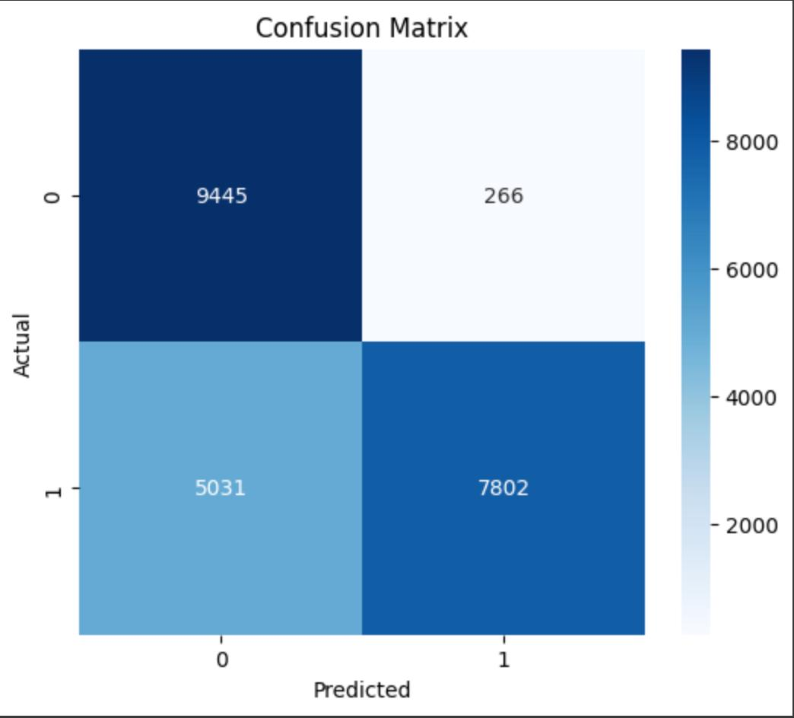
Result
1. NIDS Performance Metrics
The system achieves robust detection of network intrusions. The following metrics were derived from testing the model against the KDDTest+.txt dataset:
Key Finding: The model shows a balanced ability to identify both normal and attack traffic, with an F1-score of 0.85 for normal and 0.79 for attack packets, proving it is effective for real-world traffic classification.
METRIC | NORMAL TRAFFIC | ATTACK TRAFFIC | OVERALL/MACRO
ACCURACY | -- | -- | 0.8256
PRECISION | 0.8490 | 0.7984 | 0.8237
RECALL | 0.8524 | 0.7947 | 0.8236
F1-SCORE | 0.8507 | 0.7965 | 0.8236

Slide 15
Outcome
Research Paper (Drafted)
Real Time Deployment ( partially completed)

Slide 16
References
  [1] A. L. Buczak and E. Guven, “A Survey of Data Mining and Machine Learning Methods for Cyber Security Intrusion Detection,” IEEE Communications Surveys & Tutorials, vol. 18, no. 2, pp. 1153–1176, 2016.
[2] P. Mishra et al., “A Detailed Investigation and Analysis of Using Machine Learning Techniques for Intrusion Detection,” IEEE Communications Surveys & Tutorials, vol. 21, no. 1, pp. 686–728, 2019.
[3] A. Khraisat et al., “Survey of Intrusion Detection Systems: Techniques, Datasets and Challenges,” Cybersecurity, vol. 2, no. 1, pp. 1–22, 2019
[4] A. Joshi et al., “Using Lexical Features for Malicious URL Detection—A Machine Learning Approach,” FireEye, 2019.
[5] D. Sahoo, C. Liu, and S. C. H. Hoi, “Malicious URL Detection Using Machine Learning: A Survey,” ACM Computing Surveys, vol. 50, no. 3, pp. 1–36, 2017.
[6] F. Vanhoenshoven et al., “Detecting Malicious URLs Using Machine Learning Techniques,” in Proc. IEEE Symp. Series Comput. Intell. (SSCI), 2016, pp. 1–8

Slide 17
Thank You

